Slide 1
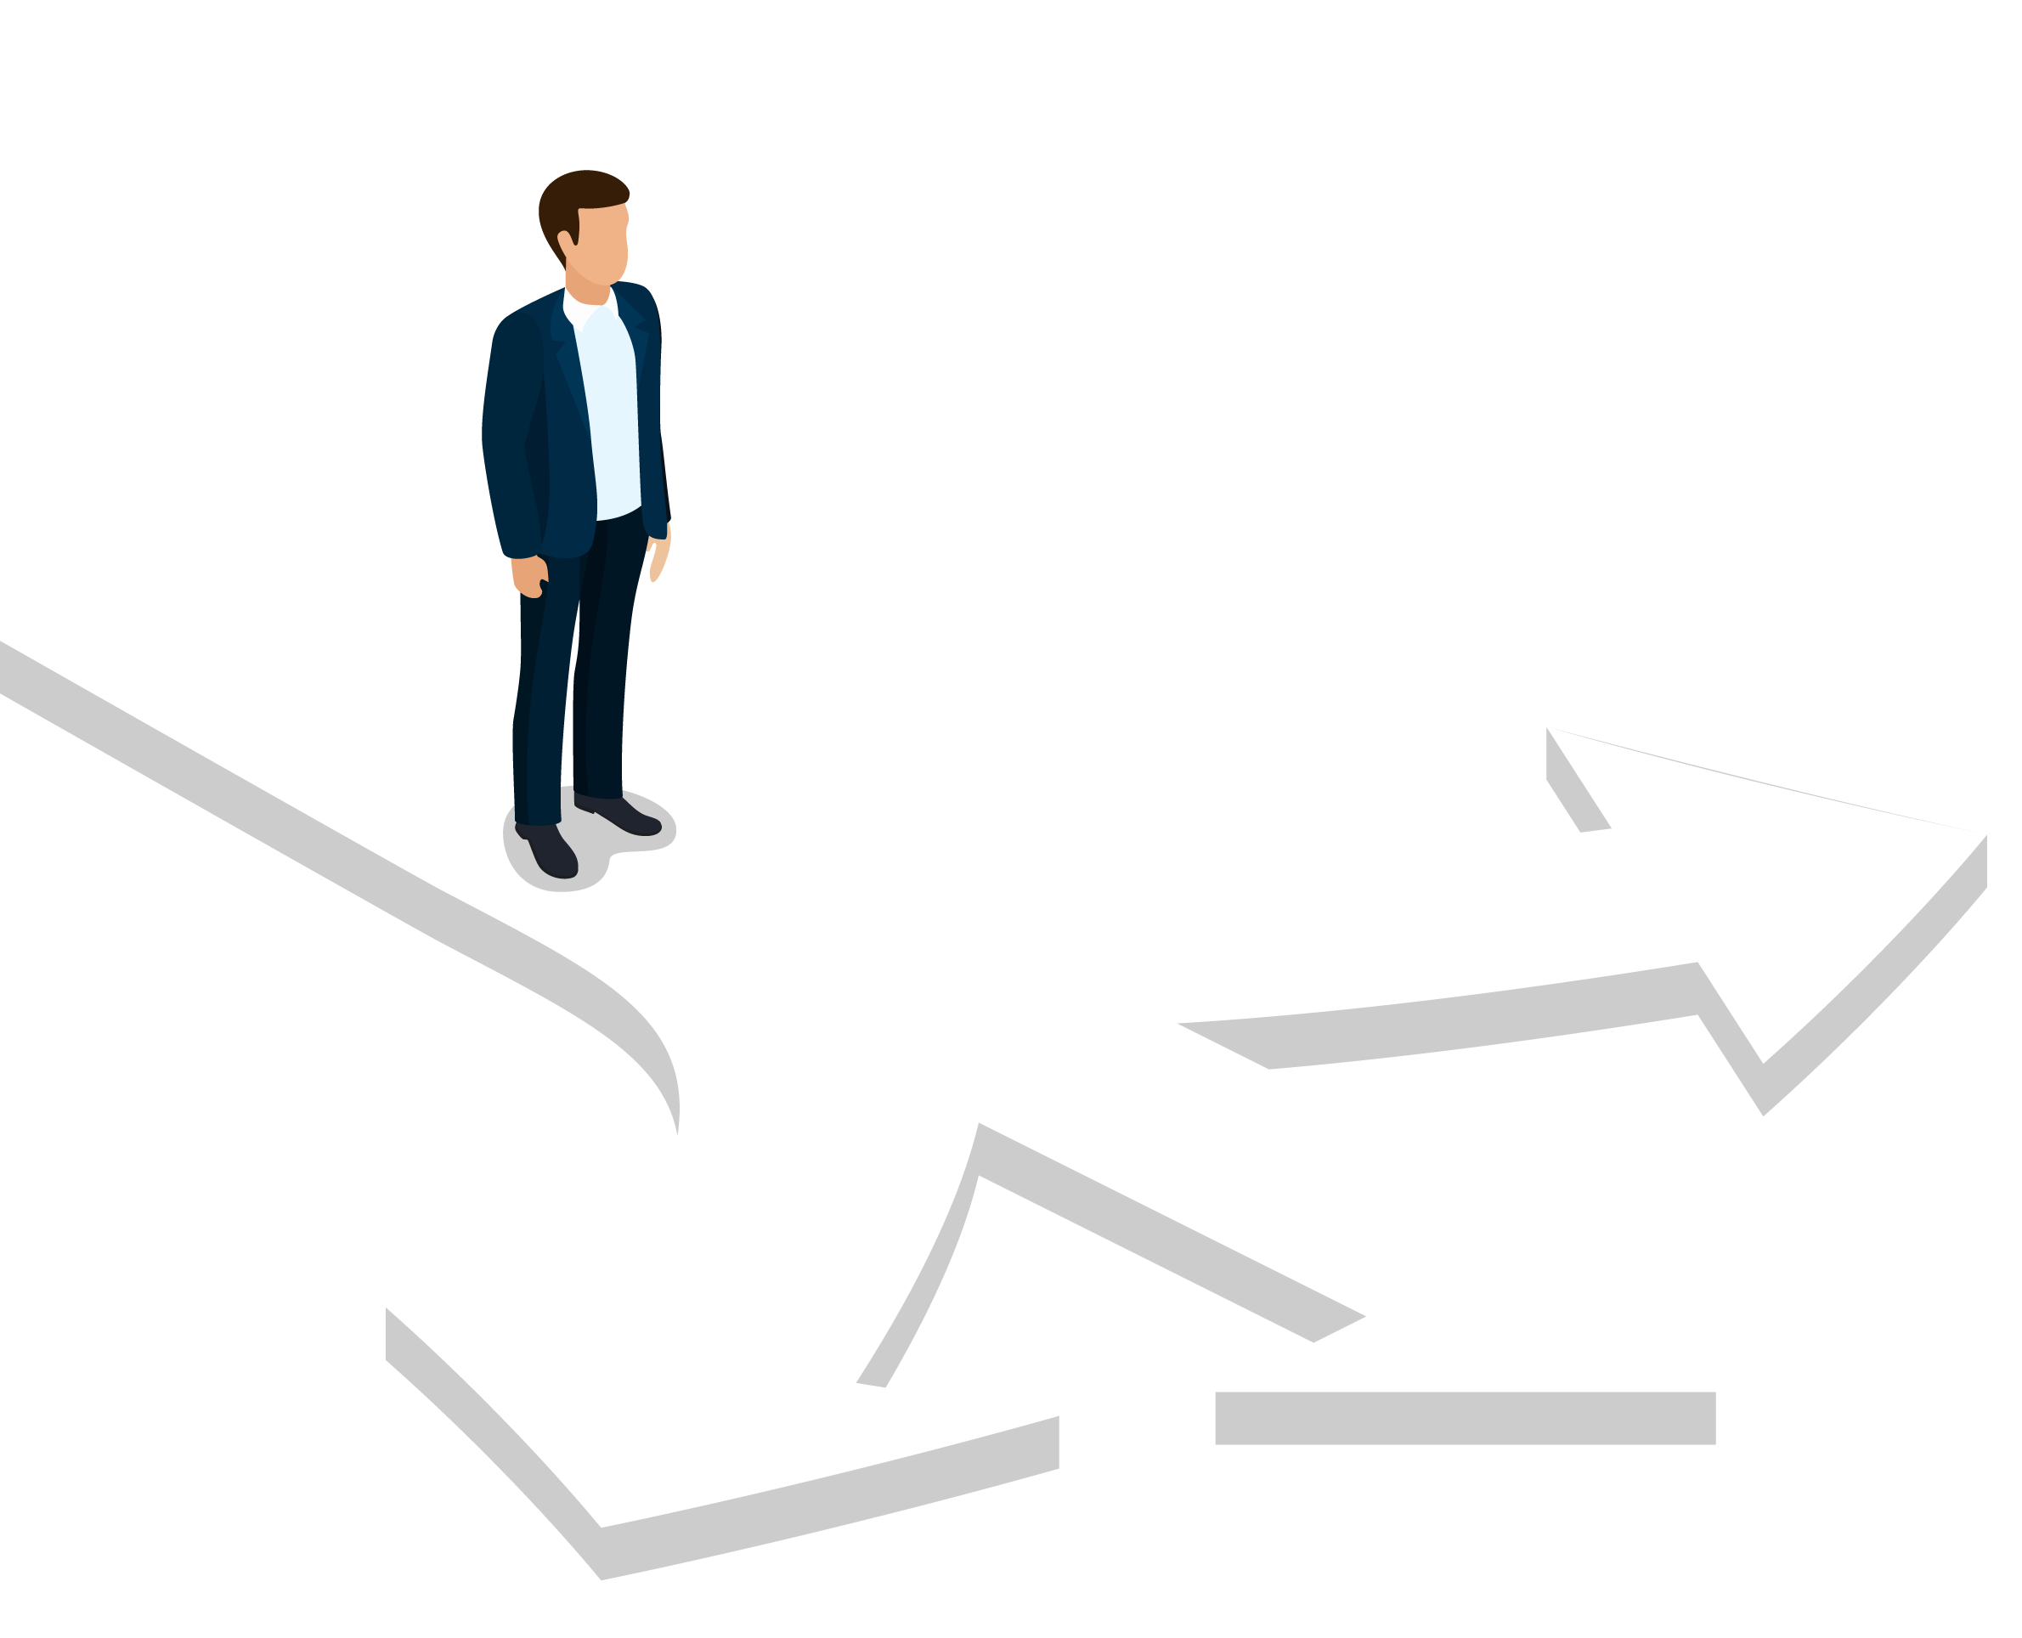
TO MAKE A CHOICE
PARTS 1 & 2

Slide 2
WOULD YOU RATHER
Have a pet crocodile
Have a pet squirrel

Slide 3
OBJECTIVES
Discuss the immense number of choices young people make each day.
Learn about the impact our choices can have on our lives.
Reflect on what kind of life you want to have and how the choices you make today can shape your future.

Slide 4
DECISIONS, DECISIONS, DECISIONS
Notes:
https://youtu.be/WmWO3E1kJT4

Slide 5
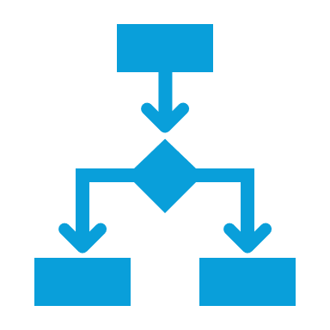
TYPES OF CHOICES
Other choices we make so often become routine
Humans make thousands of choices a day
Some choices can feel like BIG choices
Other choices we have been making since we were small
Some choices we are making for the first time

Slide 6
DISCUSSION
Share an example of a choice you make everyday

Slide 7
DAILY CHOICES
Some choices we make every day include:
What time to wake up
What to wear
Whether to brush our hair, teeth, wash our face, etc.
What to eat or drink and when
How we are going to get to school
Who we will hang out with

Slide 8
HABITS
Some choices we make so often they become a habit.
Healthy habits can help us create a healthy future.
Healthy habits may include:
taking care of personal hygiene
getting enough sleep
drinking enough water
moving your body
utilizing time management
keeping company with trustworthy folks

Slide 9
DISCUSSION
What healthy habits do you currently have?

Slide 10
HOW WE MAKE CHOICES
There are lots of ways to make a choice.
You could flip a coin.
Trust your gut and do what you feel
Avoid thinking altogether and just make a choice at random
These techniques may work for smaller decisions, but big ones definitely need more thought!

Slide 11
HOW WE MAKE CHOICES
Making Big Choices:
Think carefully about your options
Consider the many possible choices
Identify pros and cons
Think about potential consequences

Slide 12
IDENTIFYING IMPORTANT FACTORS
Start by comparing your choices.
List all the factors related to these choices.
Pick the one factor that is most important to you.
Example: You want something to drink
Options: Water, Soda, Juice, Milk
Important Factors: Energy, Health, Cost, Availability, Access
Most Important Factors: Availability
Choice: Water, because there is a water fountain nearby and you're in a rush.

Slide 13
WEIGHING PROS AND CONS
Another way to make a choice is by looking at pros and cons.
Evaluate one option at a time, write down potential upsides, and downsides.
Example: You're thirsty and you WANT a soda.
Pros:
You like soda
You can grab one at the corner store
You can get one with caffeine to get more energy for the day
Cons:
Soda costs money and you don't have money
Caffeine messes with your sleep
You'd have to wait until after school to go get money and go to the store to get a soda

Slide 14
CONSEQUENCES
Every choice we make has consequences.
Not all consequences are BAD.
Consequences are simply a result of our choices.
For example:
Choice: Brush your teeth every day
Consequence:
No cavities!
Choice: Drink lots of water daily
Consequence:
Stay hydrated!
Choice: Not enough sleep
Consequence:
Trouble waking up, late for school

Slide 15
CONSEQUENCES
It can be difficult to imagine consequences for our choices.
There are lots of different kinds of consequences too:
Short Term / Long Term Consequences
Helpful / Less Helpful Consequences
Example: You choose to get a dog.
Short Term Consequences: The dog is cute, and snuggly and brings you joy.
Long Term Consequences: You need to train the dog, pay for food, vet bills, etc.
Helpful Consequences: You have a companion to provide comfort and keep you company.
Less Helpful Consequences: Dogs need attention and care. You may lose out on other activities (hanging with friends, doing homework, etc.).

Slide 16
DISCUSSION
Think of the consequences of some of the recent choices you have made.
Did you like the consequences?

Slide 17
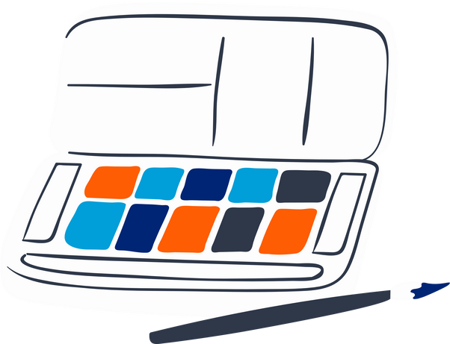
CHECK OUT
What will you do for yourself today?
Have
me-time
Eat healthy meals
Go outside
Do your hobby
Read a help book
Talk with your friends

Slide 18
BREAK TIME
Teacher, this would be a great spot to stop. Continue during the next class/period/day.

Slide 19
OBJECTIVES
Review the impact of our choices
Learn about thoughts, behaviors and feelings
Reflect on ways thoughts and feelings can impact choices (behaviors)

Slide 20
TYPES OF CHOICES
Humans make thousands of choices a day
Some choices are big, some are small, some become routine, and some we are making for the first time.
Some choices have big consequences; others seem less important
Ultimately the choices we make impact our future.

Slide 21
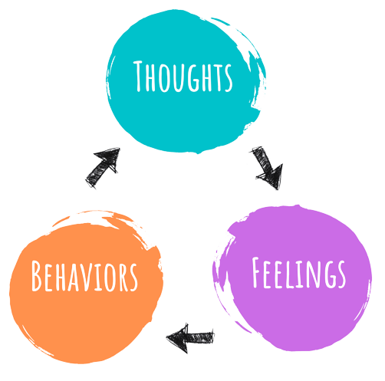
THOUGHTS, FEELINGS, BEHAVIORS
But, did you know that the choices you make are also connected to your thoughts and feelings?

Slide 22
THOUGHTS, FEELINGS, BEHAVIORS
Notes:
https://youtu.be/bq9yWrKcB5Y

Slide 23
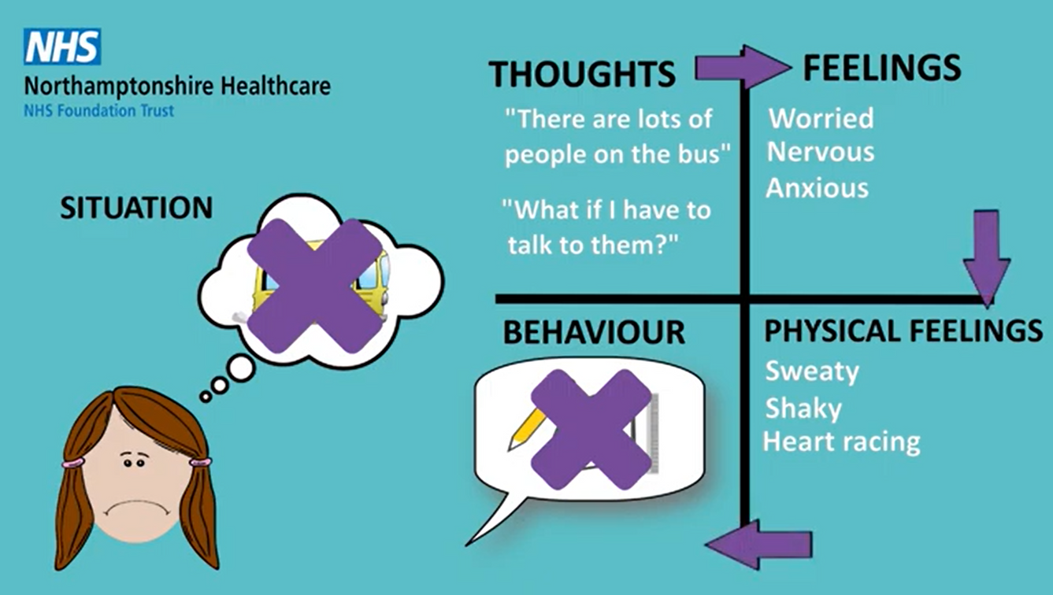
THOUGHTS, FEELINGS, BEHAVIORS
Our thoughts affect our feelings. Our feelings affect our behaviors, or the choices we make. Changing one of these factors, we can change them all!

Slide 24
DISCUSSION
Amina made a choice to try taking some deep breaths. What happened next?

Slide 25
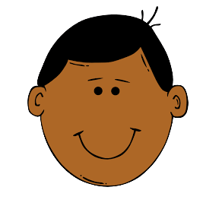
THOUGHTS, FEELINGS, BEHAVIORS
Let’s try again with a different example!
Situation: Javier is overwhelmed with schoolwork, social obligations, and family responsibilities.
Thoughts: I can’t do it all. There isn’t enough time.
Behaviors: Give up, procrastinate, ignore responsibilities.
Feeling: Exhausted, frustrated, failure

Slide 26
DISCUSSION
What choices can Javier make to change his outcome?

Slide 27
THOUGHTS, FEELINGS, BEHAVIORS
If Javier changes his behavior, he can change his thoughts and feelings, and ultimately, the outcome.
Thoughts: I am capable of figuring this out. I just need a little support.
Behaviors: Work on time management skills, ask for help
Feeling: Tired but hopeful

Slide 28
THOUGHTS, FEELINGS, BEHAVIORS
If Javier changes his thoughts, he can change his feelings and behaviors, and ultimately, the outcome.
Thoughts: I am capable of figuring this out. I just need a little support.
Behaviors: Work on time management skills, ask for help
Feeling: Tired but hopeful

Slide 29
THOUGHTS, FEELINGS, BEHAVIORS
If Javier changes his feelings by using a coping skill like deep breathing or moving his body, he can change his thoughts and behaviors, and ultimately, the outcome.
Thoughts: I am capable of figuring this out. I just need a little support.
Behaviors: Work on time management skills, ask for help
Feeling (after coping): Tired but hopeful

Slide 30
DISCUSSION
Can you make a choice today to help change your thoughts or feelings?

Slide 31
CHECK OUT
What will you do for yourself today?
Journal on how you feel today
Listen to a podcast or music
Write a poem or a short story
Create a mood music playlist
Find a new exciting thing
Cook your favorite meal

Slide 32
Committed to fostering a safe and respectful District, school and community culture where the seeds of peace and justice are sown so that all students and staff can lead safe, purposeful and academically fruitful lives.
Connect with us at bit.ly/LAUSD-HRDE

